Slide 1
Organs that need Transplants
Transplant Organ | Cause | Why
Kidney | DM HTN Glomerulonephritis | Long term option for pts with ESRD to improve QOL
Liver Non cholestatic cirrhosis | Hep B, C Alcohol Autoimmune | Lifesaving
Heart | HF class III or IV | Transplant if 1 year mortality risk >25%

Slide 2
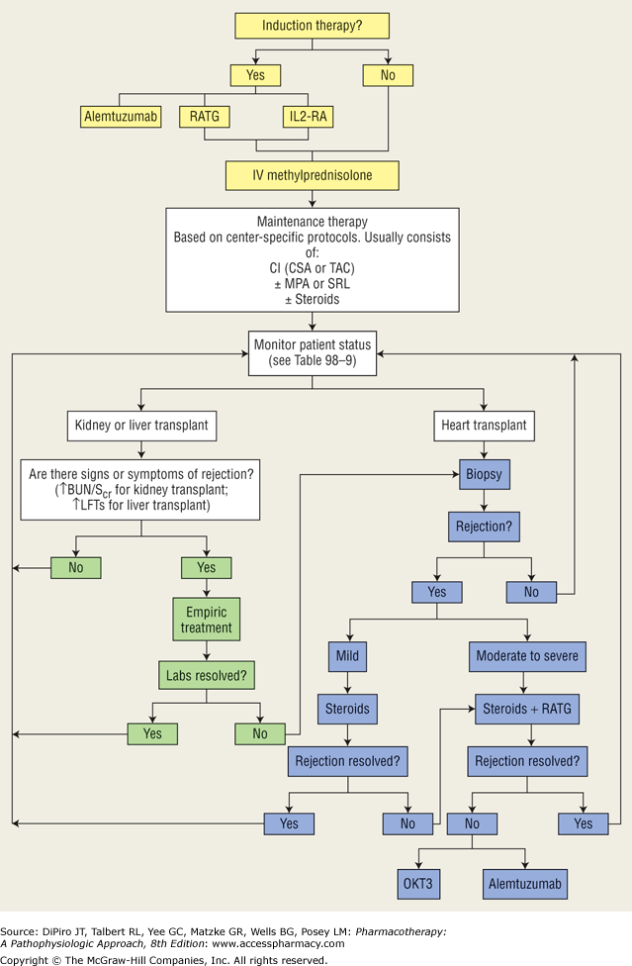
Abbreviations:
IL2RA: Interleukin 2 Receptor Antag
RATG: Rabbit antithymocyte immunoglobulin
CI: Calcineurin Inhibitor
CSA: Cyclosporin
TAC: Tacrolimus
MPA: Mycophenolate
SRL: Sirolimus
OKT3: Muromonab CD3
Notes:
RATG is approved only for the treatment of acute allograft rejection in kidney transplantations

Slide 3
Acute Rejection: Caused by infiltration of T cells into the allograft, which triggers inflammatory and cytotoxic effects on the graft.
Chronic Rejection: Interactions between CD4+ and CD8+ T cells, and B cells
Class | Drug | Abb | MOA | Notes
Corticosteroids | Methylprednisolone (IV) Prednisone |  | block cytokine activation inhibiting interleukins. IL promote development of T and B cells | Acute (3-5 days): Psychosis Chronic: Cushings Tx: Induction and Maintenance
Calcineurin Inhibitors | Cyclosporine Tacrolimus | CSA TAC | Block T-cell proliferation by inhibiting the production of IL-2 | Nephrotoxicity
Antimetabolites | Mycophenolate Acid Mycophenolate Mofetil Mycophenolate Sodium Azathioprine | MPA MMF MPS AZA | Inhibit DNA polymerase --> decrease T and B cell proliferation
Rapamycin Inhibitors | Sirolimus | SRL/SIR | Inhibits the response to cytokines (protein released by T and B cells)
Anti-Thymocyte | Atgam (horse) Thymoglobulin (rabbit) | ATG RATG | Bind and lyse T cells | Tx induction & acute rejection Bone marrow suppression
Muromonab-CD3 | OKT3 | OKT3 | Bind to mature T cells → inactive T cells | Cytokine-release syndrome
Notes:
CD4 (cluster of differentiation 4) is a glycoprotein found on the surface of immune cells such as T helper cells, monocytes, macrophages, and dendritic cells

Slide 4
Induction Therapy
When: begun before, at the time of, or immediately after transplantation.
Give Quadruple Induction Therapy (most common):
Mycophenolate Mofetil
(Cellcept)
Or
Mycophenolate Sodium
Or
Sirolimus
Cyclosporine
Or
Tacrolimus
(High dose)
IV Methylprednisone
+
+
Atgam
+
Drug | Dose
Methylprednisolone | 250 – 1000 mg IV daily at 7 AM for 3 days or Prednisone 200 mg PO daily Taper over 5 days to 20 mg daily d/c over a period of months
Cyclosporine | 4-12 hr pre-transplant: 15 mg/kg PO x1 1-2 weeks post-transplant: 6 mg/kg/day PO BID Reduce 5% per week until 5 mg/kg/day PO BID
Atgam | Start within 24 hours of transplant 15-20 mg/kg/day x 7-10 days adjusted for leukopenia and thrombocytopenia
Mycophenolate Mofetil | 1000 mg PO BID Adjusted for leucopenia and thrombocytopenia

Slide 5
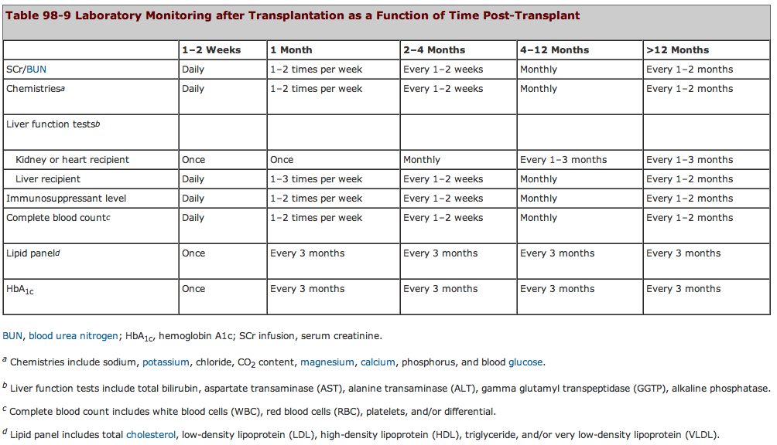
Maintenance = Monitor

Slide 6
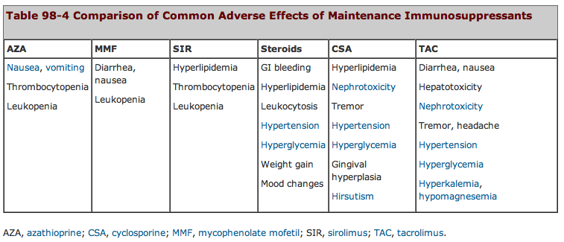
Maintenance = Monitor

Slide 7
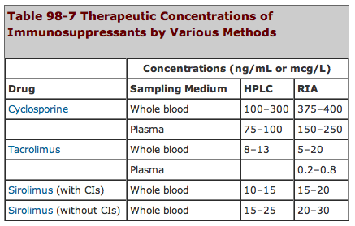

Slide 8
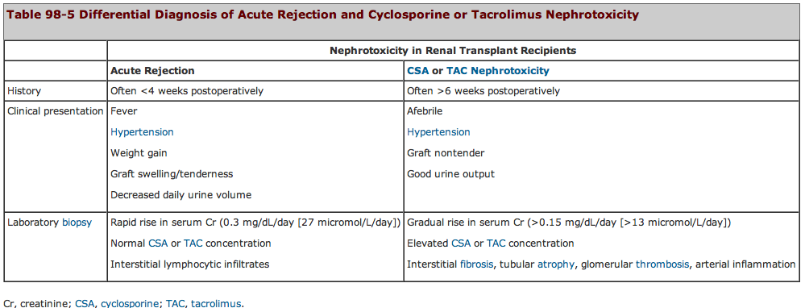
Cyclosporine/Tacrolimus Renal Toxicity Vs Kidney Rejection

Slide 9
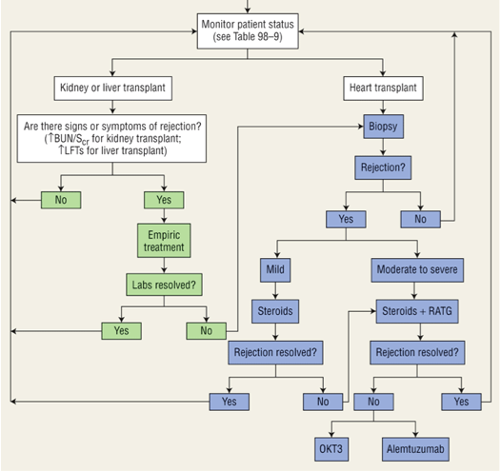
Rejection Therapy
Goal: prevent irreversible injury to allograft
Mild Rejection | Dose
Prednisone | 2-3 mg/kg/day with rapid taper
or
Solumedrol | 500 mg IV Piggy Back x3 days
Severe Rejection | Dose
Steroid | “ “
+
Thymoglobulin
Rejection NOT resolved | Dose
Methylprednisolone | 125 mg IV
+
Diphenhydramine | 25-50 mg PO 30 min pre-OKT3
+
Acetaminophen | 650 mg PO 30 min pre-OKT3
+
OKT3 | 5 mg IVP qday x7-10 days
Notes:
Calcineurin inhibitors (CIs), such as cyclosporine and tacrolimus, which inhibit interleukin (IL)-2 and thus block T-cell activation are the backbone of immunosuppressive regimens. However, they are associated with significant adverse effects, namely, nephrotoxicity and neurotoxicity.
Corticosteroids are a key component of immunosuppressive regimens because they block the initial steps in allograft rejection. However, the adverse effects associated with their long-term use have prompted the investigation of corticosteroid-free immunosuppressive protocols. Corticosteroids remain the cornerstone of the treatment of allograft rejection.
Antiproliferative agents such as azathioprine and mycophenolate inhibit T-cell proliferation by altering purine synthesis to prevent acute rejection. Bone marrow suppression is the most significant adverse effect associated with these agents.

